Slide 1
Spectral Clustering
Kanchan Luitel

Slide 2
Introduction
Unsupervised Learning
- no labels needed
- helps with discovering hidden patterns in the data
Cluster Analysis
- Group together similar instances
- Approaches to cluster analysis
- compactness and connectivity

Slide 3
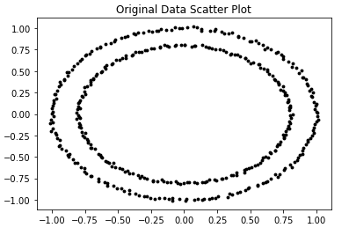
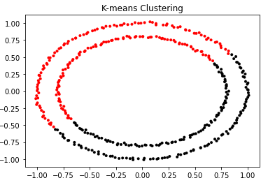
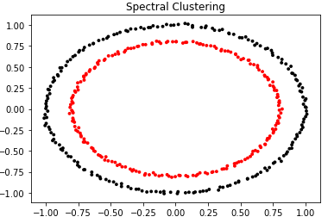
Clustering
Clustering
-compactness and connectivity
Applications
market segmentation, social network analysis, search result grouping, medical imaging, image segmentation, anomaly detection, Data Compression, Privacy Preservation ( Google )

Slide 4
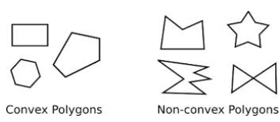
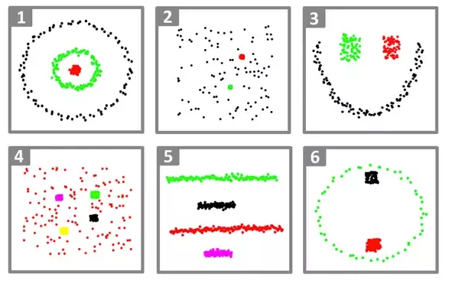
Graph Clustering
K-means clustering
- most popular clustering algorithms
- “k” number of centroid adjusted in iterative process to find clusters
Limitations of K-means clustering
Requires number of clusters to be known in advance
Struggles when clusters have irregular non-convex shapes
Will always produce an answer finding the required number of clusters even if the data isn’t clustered (or clustered in that many clusters).
Requires linear cluster boundaries
It requires multiple restarts at times to find the local minima (i.e. the best clustering).

Slide 5
Similarity Graphs
Given a set of data points x1, …Xn and some notion of similarity s_{ij} >= 0 between all pairs of data points xi and xj, the intuitive goal of clustering is to divide the data points into several groups such that points in the same group are similar and points in different groups are dissimilar to each other¹.
Sets as vectors: Measure similarity by the cosine distance
Sets as sets: Measure similarity by the Jaccard distance
Sets as points: Measure similarity by Euclidean distance

Slide 6
Representing Graphs
Definition: Let G = (V, E) be a simple graph with |V| = n. Suppose that the vertices of G are listed in arbitrary order as v₁, v₂, …, v_{n}.
The adjacency matrix A (or A_{G}) of G, with respect to this listing of the vertices, is the n×n zero-one matrix with 1 as its (i, j) entry when v_{i} and v_{j} are adjacent, and 0 otherwise.
In other words, for an adjacency matrix A = [a_{ij}],
a_{ij} = 1 if {v_{i}, v_{j}} is an edge of G, a_{ij} = 0 otherwise.

Slide 7
Adjacency Matrix (A)
a
Vertex
Adjacent Vertices
b
d
a
b, c, d
c
b
a, d
c
a, d
d
a, b, c

Slide 8
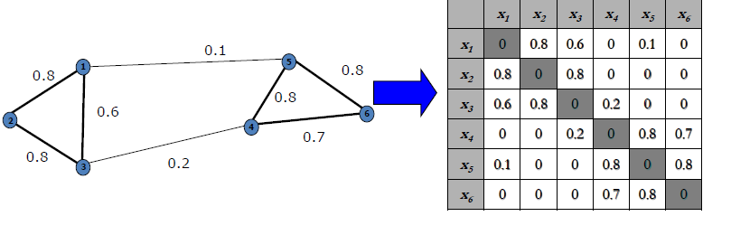
Similarity Matrix (W)

Slide 9
Degree Matrix(D)
a
Vertex
Adjacent Vertices
b
d
a
b, c, d
c
b
a, d
c
a, d
d
a, b, c
3 | 0 | 0 | 0
0 | 2 | 0 | 0
0 | 0 | 2 | 0
0 | 0 | 0 | 3

Slide 10
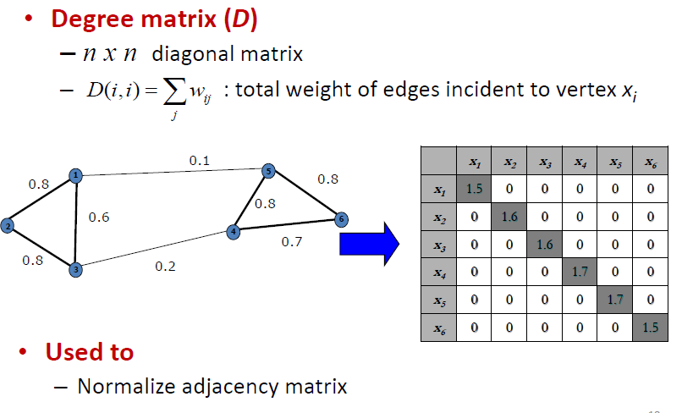
Degree Matrix(D)

Slide 11
Laplacian Matrix (L)
Laplacian Matrix (L) = Degree Matrix(D) – Adjacency Matrix(A)
If weighted graph :
Laplacian Matrix (L) = Degree Matrix(D) – Similarity Matrix (W)

Slide 12
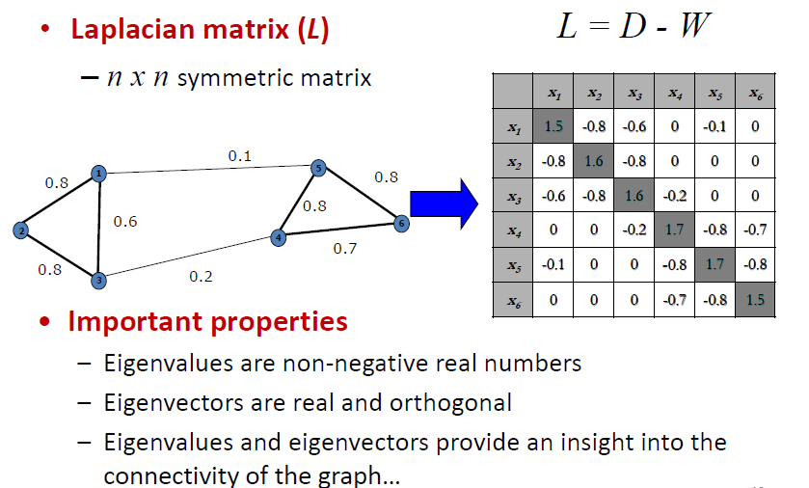
Laplacian Matrix of a Graph

Slide 13
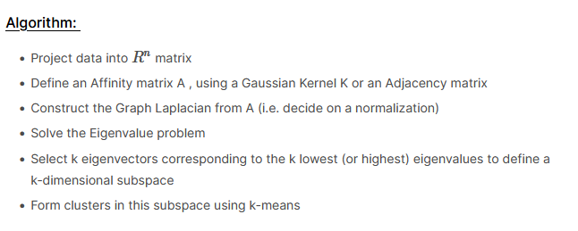
Spectral Clustering

Slide 14
Spectral Clustering – TO DO
How to decide number of clusters ? How does the algorithm decide when it is a good “no of clusters” ?
Explanation of eigenvectors of Laplacian matrix. How do we come to conclusion based on eigenvectors of certain eigenvalues ?
What are different ways to create similarity matrix (any papers) ?
How to conceptually deal with big dataset ?

Slide 15
Eigenvalues and Eigenvectors
The eigenvectors x and eigenvalues λ of a matrix A satisfy
Ax = λx
If A is an n x n matrix, then x is an n x 1 vector, and λ is a constant.
The equation can be rewritten as (A - λI) x = 0, where I is the
n x n identity matrix.

Slide 16
Computing Eigenvalues
Since x is required to be nonzero, the eigenvalues must satisfy
det(A - λI) = 0
which is called the characteristic equation. Solving it for values
of λ gives the eigenvalues of matrix A.

Slide 17
Eigenvalue and Eigenvector

Slide 18
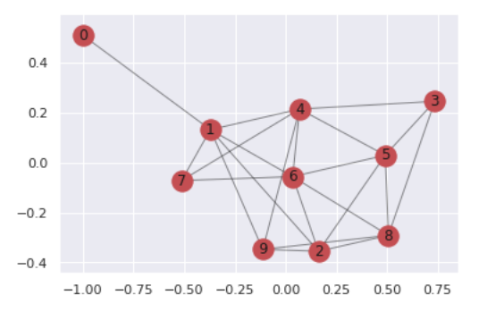
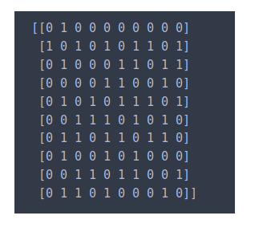
Example

Slide 19
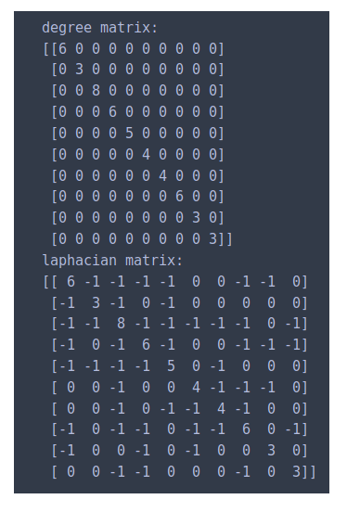
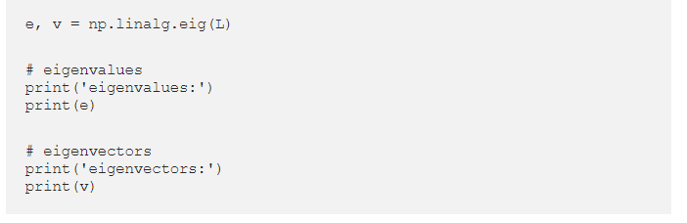
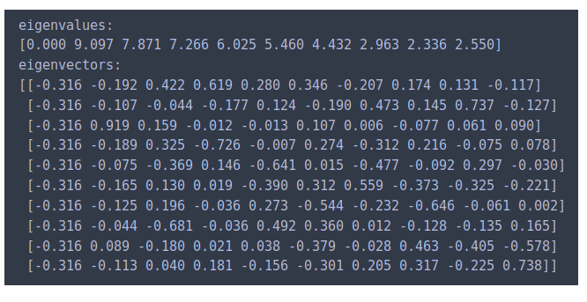
Example

Slide 20
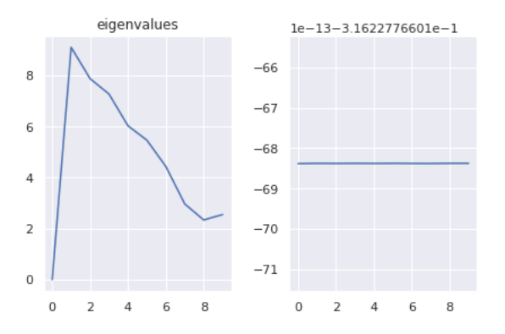

Example

Slide 21
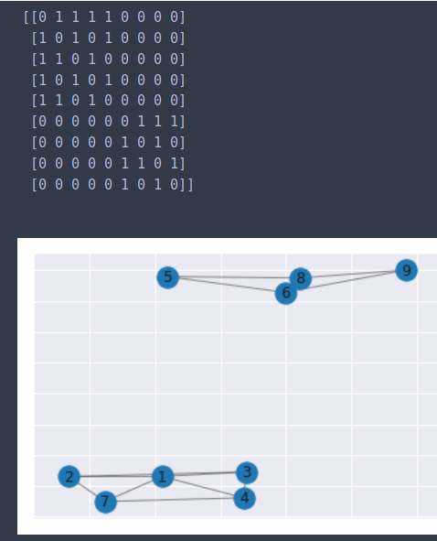
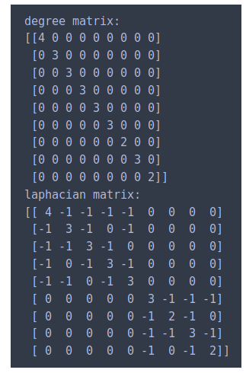
Example

Slide 22
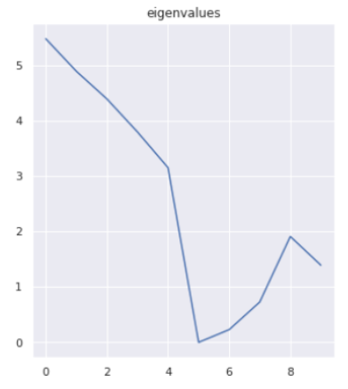
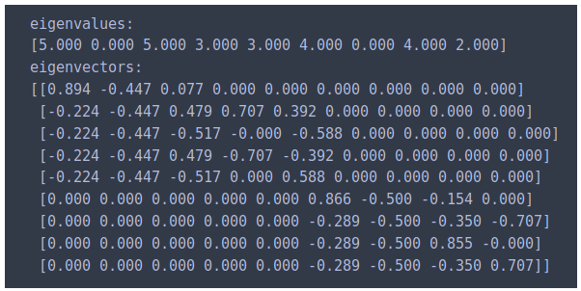
Example

Slide 23
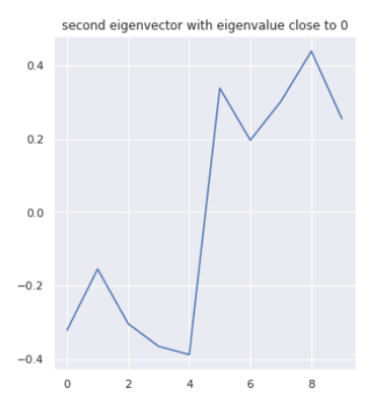
Example

Slide 24
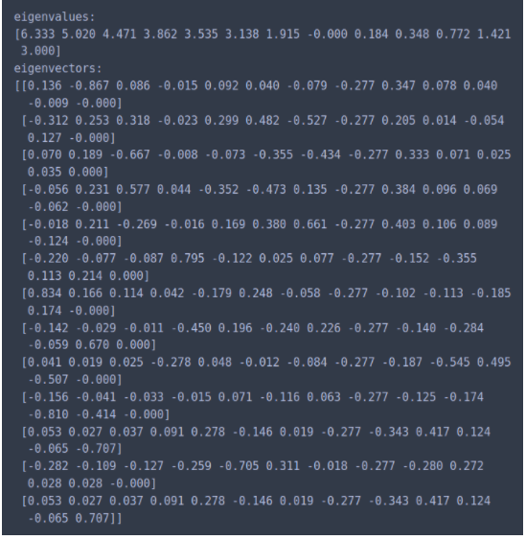
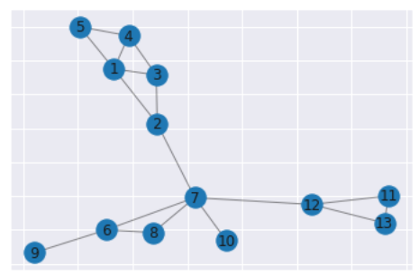
Example

Slide 25
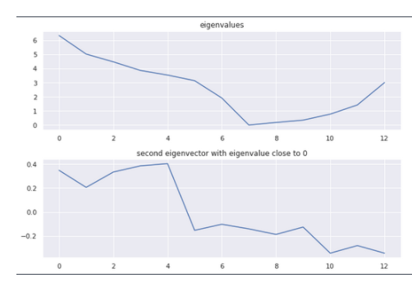
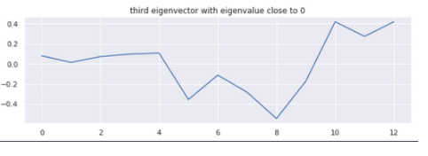
Example

Slide 26
Observation
- The smallest eigenvalue of L is 0, the corresponding eigenvector is the constant one vector 1
- L has n non-negative, real valued eigenvalues 0 = λ1 <= λ2 <= λ3 <= … λn
- The multiplicity k of the eigenvalue 0 of L equals the number of connected components A1, . . . ,Ak in the graph.

Slide 27
TO DO
Why Laplacian matrix ? How is it connected to Laplacian operator of a function ?
What other options for clustering are available ?
Why it works ?
DEMO ( with code )
Better Mathematical Interpretation
Summarize ongoing research on this topic and what they are trying to achieve
Why use eigenvalue ? How does eigenvalue give the notion of connectedness of the graph ? What is its mathematical interpretation?

Slide 28
TO DO
Unnormalized vs. normalized spectral clustering
Graph cut, ratio cut
Random walks point of view
K means clustering
Programming implementation ( python – jupyter notebook)

Slide 29
References
1 - https://towardsdatascience.com/understanding-k-means-clustering-in-machine-learning-6a6e67336aa1

